Slide 1

Impacts of Power, Area, and Performance of Various Branch Predictors
Thomas Gaul, Jackson Hafele, Gregory Ling
CPR E 581 Final Project Fall 2023
Notes:
‹#›

Slide 2
Motivation
Explored performance of many branch predictors in class
Extend this knowledge to have hardware cost context
Cost effectiveness of branch prediction schemes
With the decline of Moore’s Law and Dennard Scaling
Power and area become a limited commodity to be budgeted
Notes:
Gregory

Slide 3
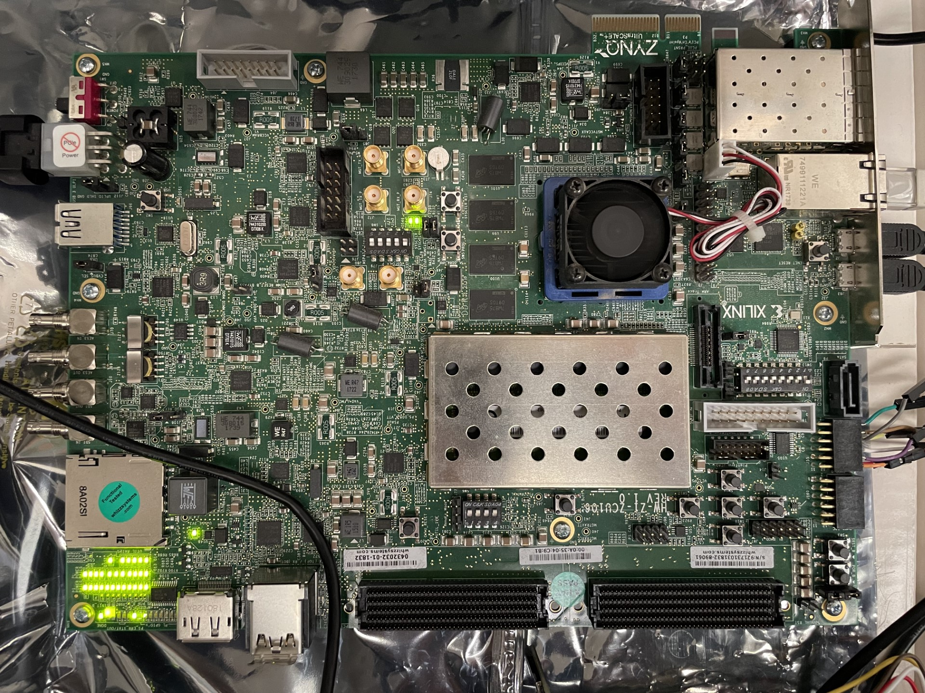
Main Idea
Explore using Chipyard to generate an out-of-order core
Compare branch predictors in terms of power, area, and performance
TAGE, Tournament, GShare - Provided
Global, Local, Null - Custom
Explore running SPEC benchmarks on a Chipyard softcore on an FPGA
Utilize Firemarshal for Linux distribution
Notes:
Gregory

Slide 4
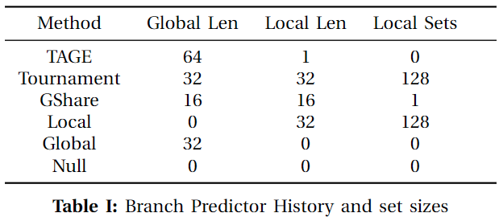
Methodology
Use Chipyard to generate OOO cores with each branch predictor
Use the ZCU106 configuration provided by Jordan’s group
Use Vivado to synthesize, generate the bitstream, program the ZCU106, and measure power/area usage
Use SPEC benchmarks to provide representative example programs to measure performance
Notes:
Gregory

Slide 5
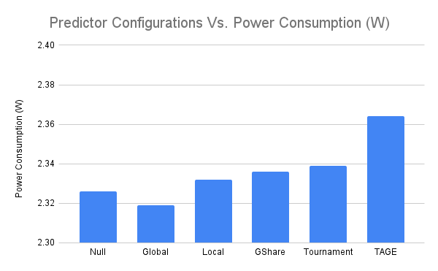
Results - Power
Notes:
Jake

Slide 6
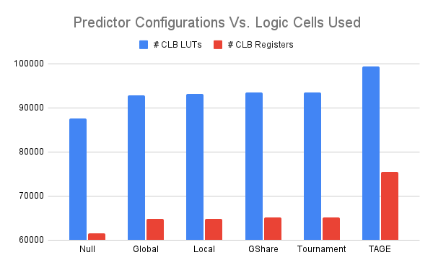
Results - Utilization
Notes:
Jake

Slide 7
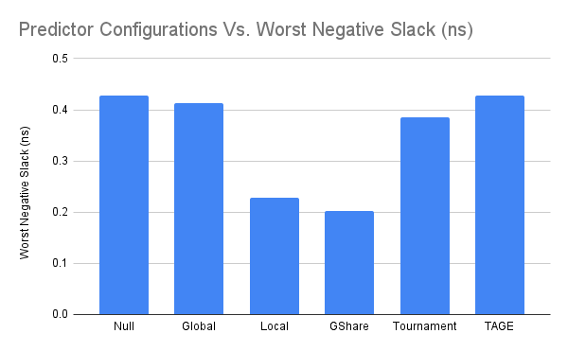
Results - Timing
Notes:
Jake

Slide 8
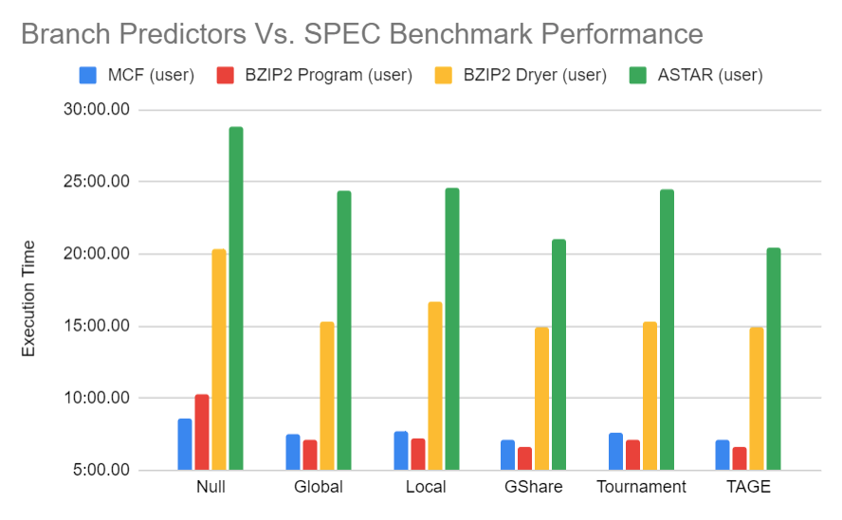
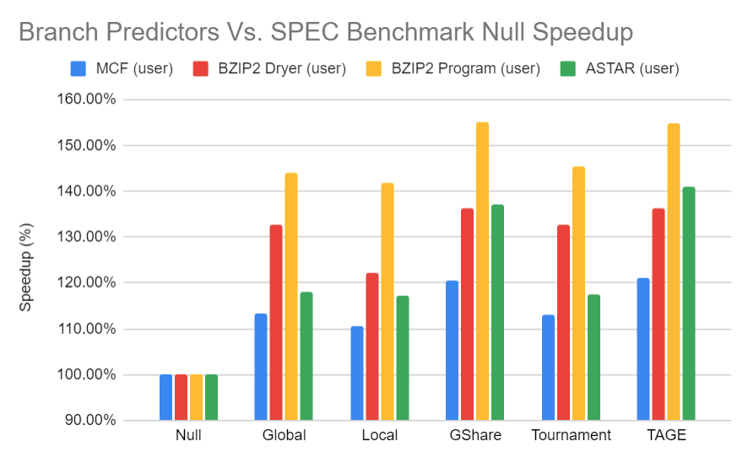
Results - Execution Time, Speedup
Notes:
Jake

Slide 9
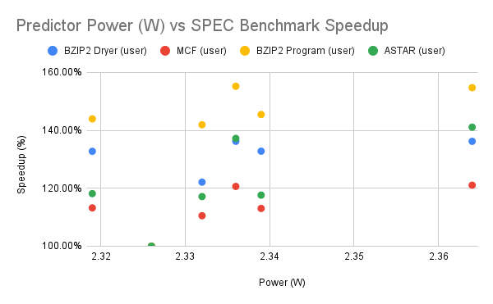

Analysis
All predictors more performant than Null
Global consumes less power than Null
Tournament less performant than GShare despite more power
TAGE consumes much more power relative
GShare
TAGE
Global
Local
Tournament
NULL
Notes:
Thomas

Slide 10
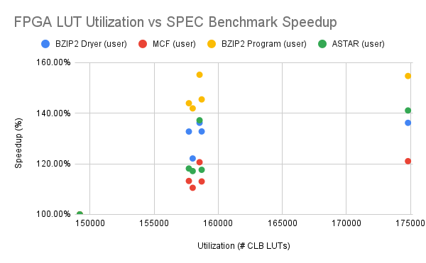
Analysis
NULL consumed marginally less LUTs
Utilization of Global, Local, and GShare very similar
TAGE consumed far more LUTs, little performance benefit
How much could changing global/local sizes affect each predictor?
GShare/Tournament
TAGE
Global/Local
NULL
Notes:
Thomas

Slide 11
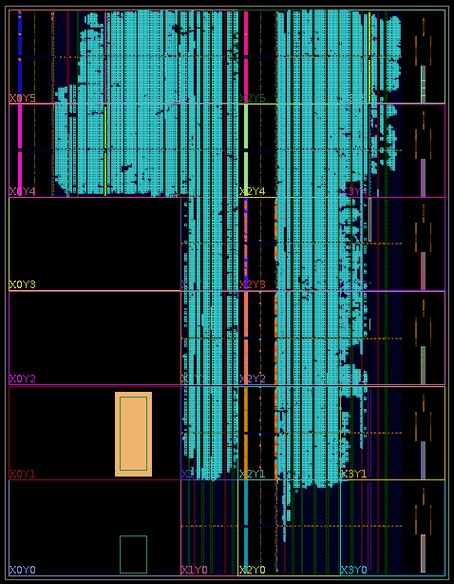
Future Work
Additional Benchmarks
Run full benchmarks
Multiple configurations for one predictor type
Hardware Security
Notes:
Thomas

Slide 12

Conclusion
Successfully generated RTL for 6 branch prediction schemes with BOOM Core
Attained Vivado implementation results for area, power, and timing reports
Compared the performance impacts of all 6 branch predictors for BZIP2, ASTER, and MCF
Notes:
Thomas

Slide 13
References
A. Amid, D. Biancolin, A. Gonzalez, D. Grubb, S. Karandikar,
H. Liew, A. Magyar, H. Mao, A. Ou, N. Pemberton, P. Rigge,
C. Schmidt, J. Wright, J. Zhao, Y. S. Shao, K. Asanovi ́c, and
B. Nikoli ́c, “Chipyard: Integrated design, simulation, and im-
plementation framework for custom socs,” IEEE Micro, vol. 40,
no. 4, pp. 10–21, 2020.

Slide 14

Questions

Slide 15
Learning Achieved through the project
Learned more about Open-Source tools (Chipyard BOOM)
Applied multiple branch prediction schemes covered in class to real hardware
Utilized and expanded on previous work with Chipyard and BOOM Core
Compared the impacts of different predictors for power, area, and performance
Notes:
Thomas

